Slide 1
Precise Analysis

Slide 2
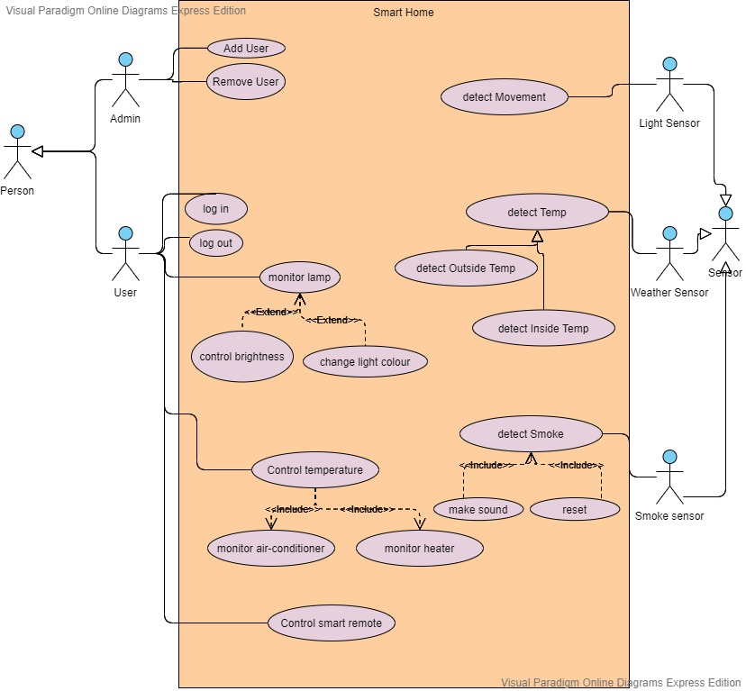
USE CASE DIAGRAM

Slide 3
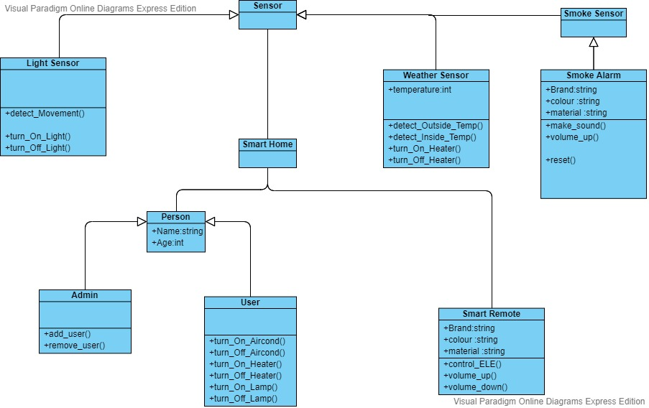
Main Class Diagram For Smart Home System

Slide 4
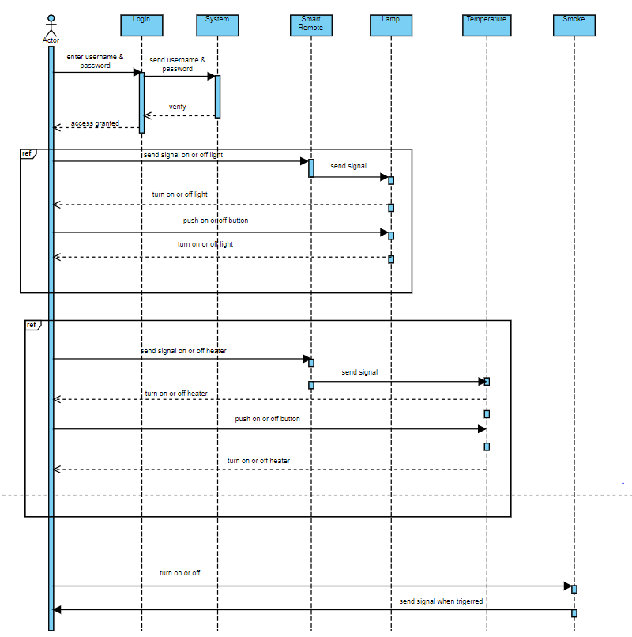
SEQUENCE DIAGRAM FOR SMART REMOTE

Slide 5
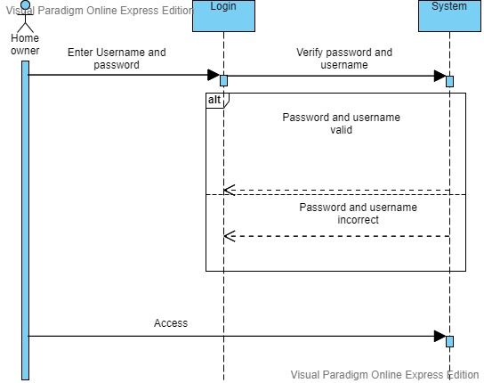
SEQUENCE DIAGRAM FOR LOGIN

Slide 6
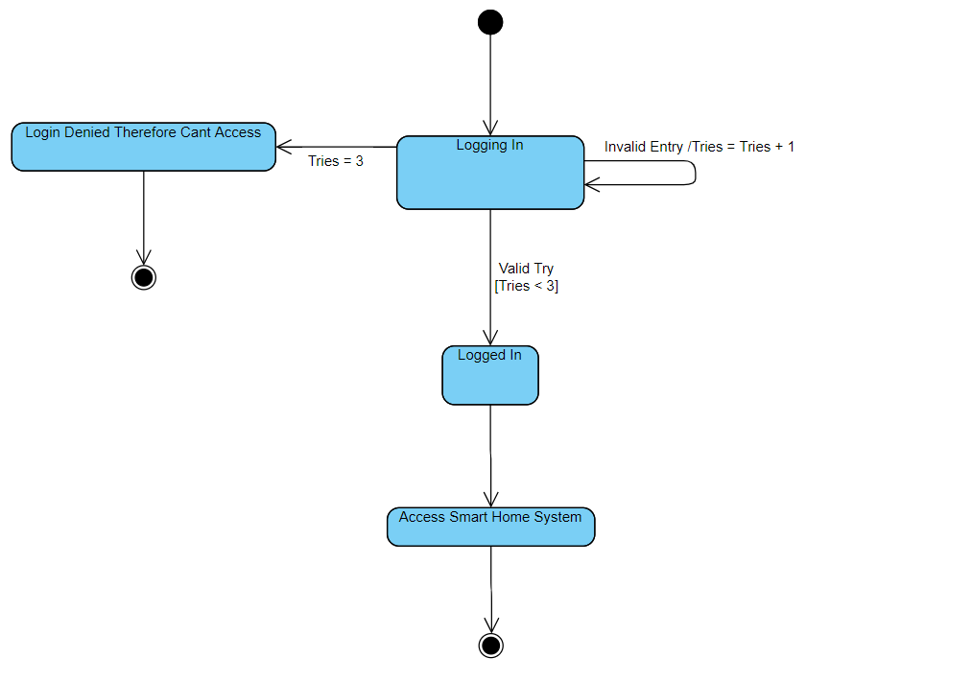
State Diagram For Smart Home Login System

Slide 7
SCENARIO 1: HEATING & COOLING

Slide 8
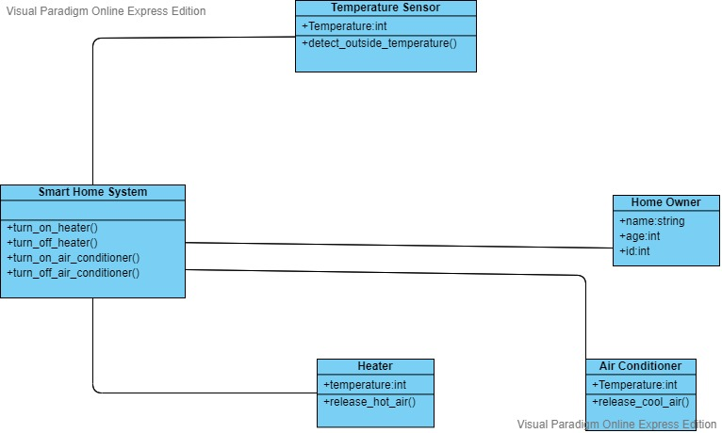
Class Diagram for Heating And Cooling

Slide 9
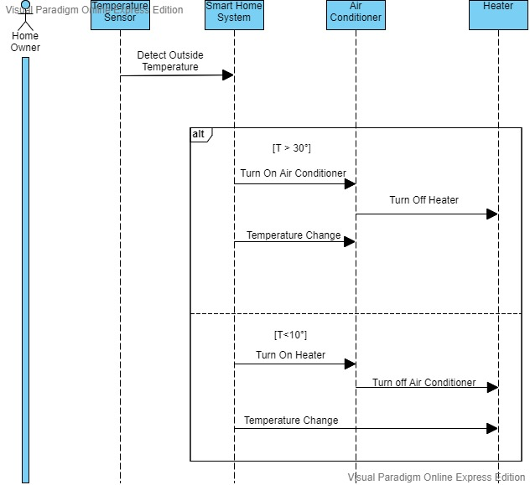
Sequence Diagram for Heating And Cooling

Slide 10
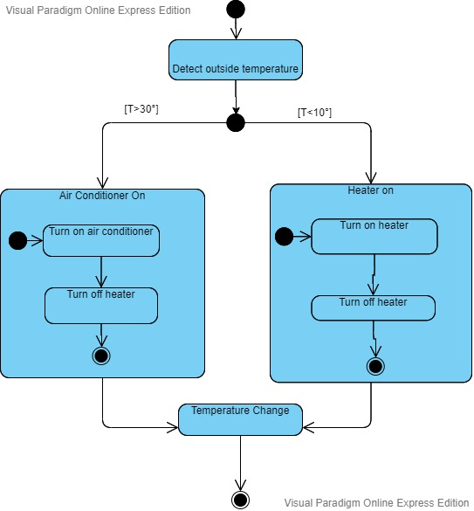
State Diagram for Heating And Cooling

Slide 11
SCENARIO 2: LIGHT & MOTION

Slide 12
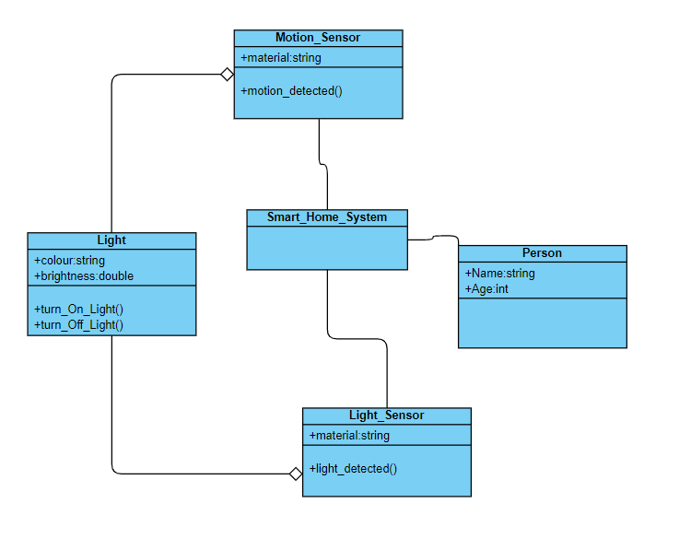
CLASS DIAGRAM FOR LIGHT CONTROLLING INITIATE BY SENSOR

Slide 13
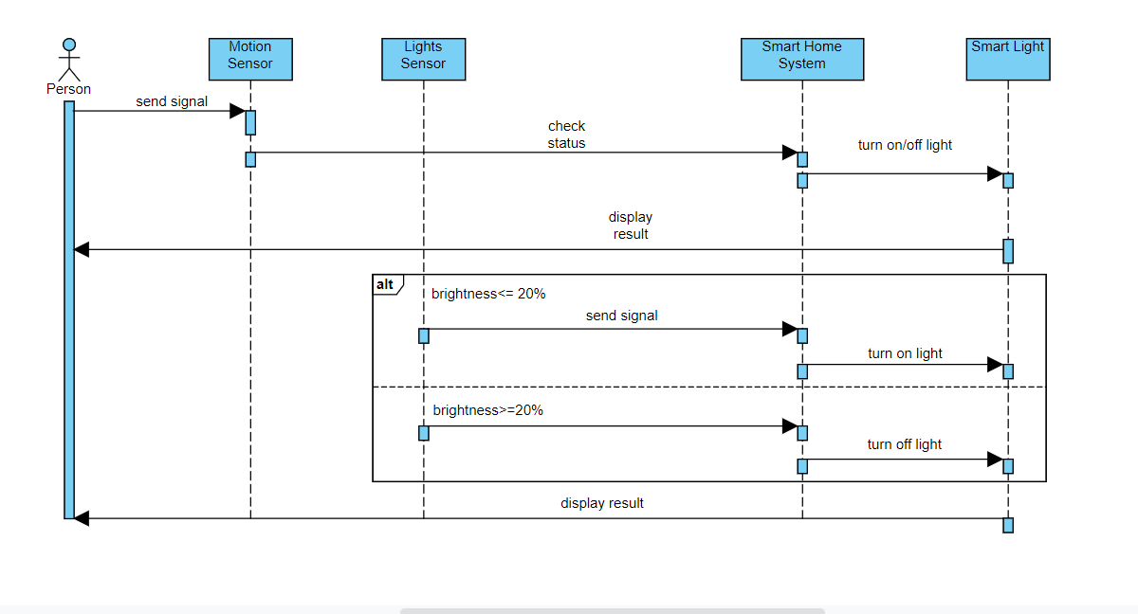
SEQUENCE DIAGRAM FOR LIGHT CONTROLLING INITIATE BY SENSOR

Slide 14
STATE DIAGRAM FOR LIGHT AND MOTION SENSOR
Initialize
NoMotionDetected
MotionDetected
entry/turnOffLight()
entry/turnOffLight() do/musicOff()
do/heaterOff()
entry/turnOnLight() do/musicOn()
do/heaterOn()
Lightdetected
Lightdetected
entry/turnofflight()
entry/turnofflight()
Nolightdetected entry/turnonlight() do/VolB=70%
Nolightdetected entry/turnonlight() do/VolB=70%

Slide 15
SCENARIO 3: FIRE ALARM

Slide 16
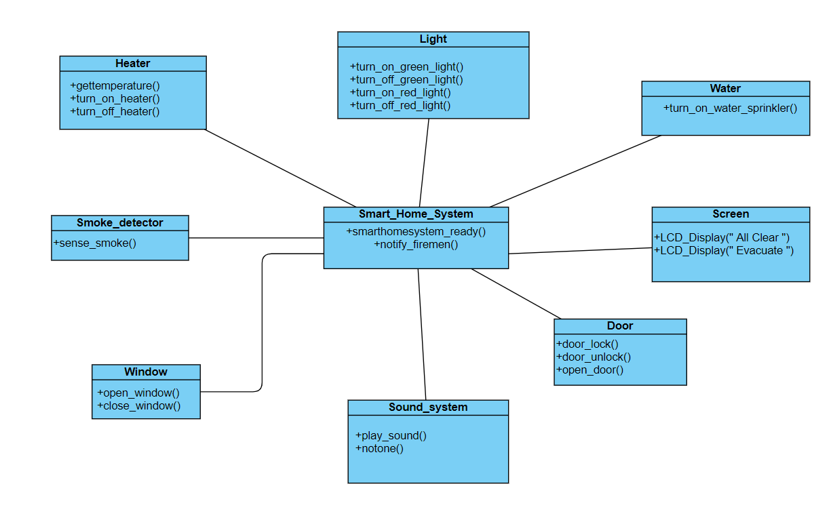
CLASS DIAGRAM FOR SMART FIRE ALARM

Slide 17
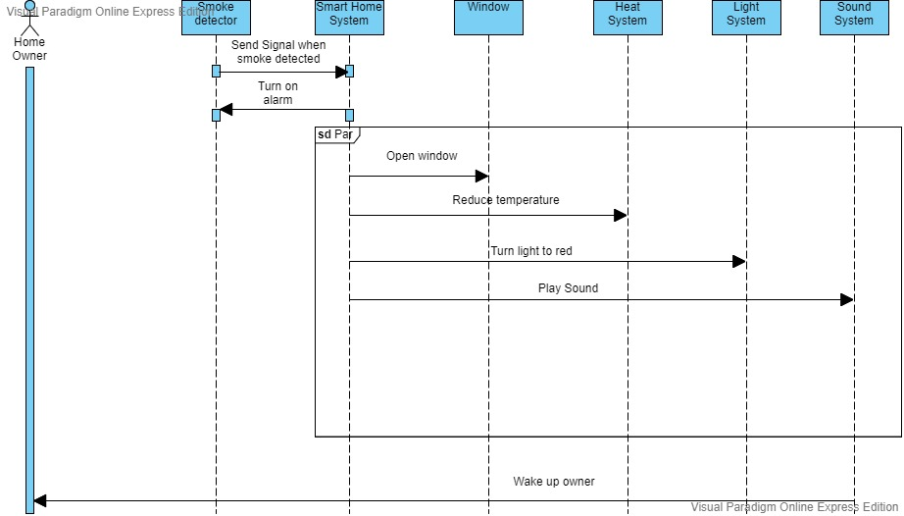
SEQUENCE DIAGRAM FOR SMART FIRE ALARM

Slide 18
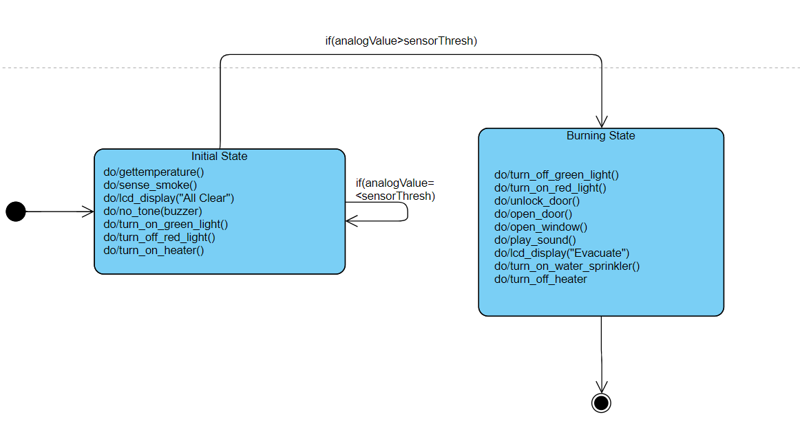
STATE DIAGRAM FOR SMART FIRE ALARM

Slide 19
SCENARIO 4: SMART DOOR LOCK

Slide 20
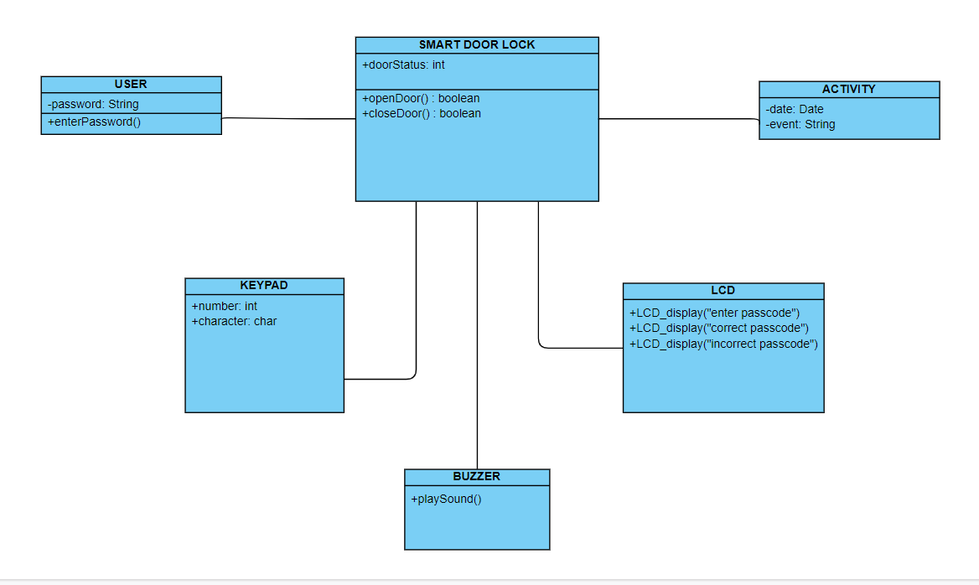
CLASS DIAGRAM FOR SMART DOOR LOCK

Slide 21
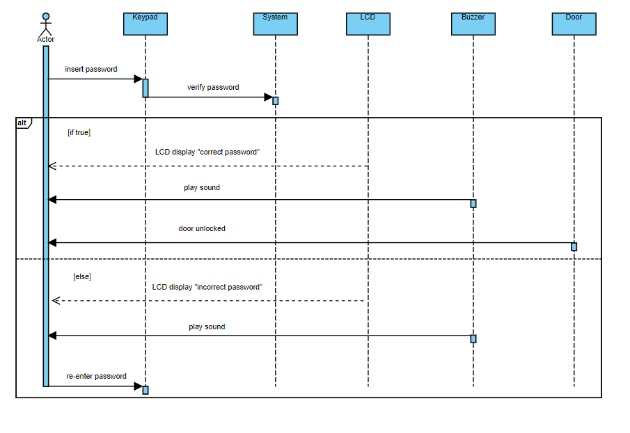
SEQUENCE DIAGRAM FOR SMART DOOR LOCK

Slide 22
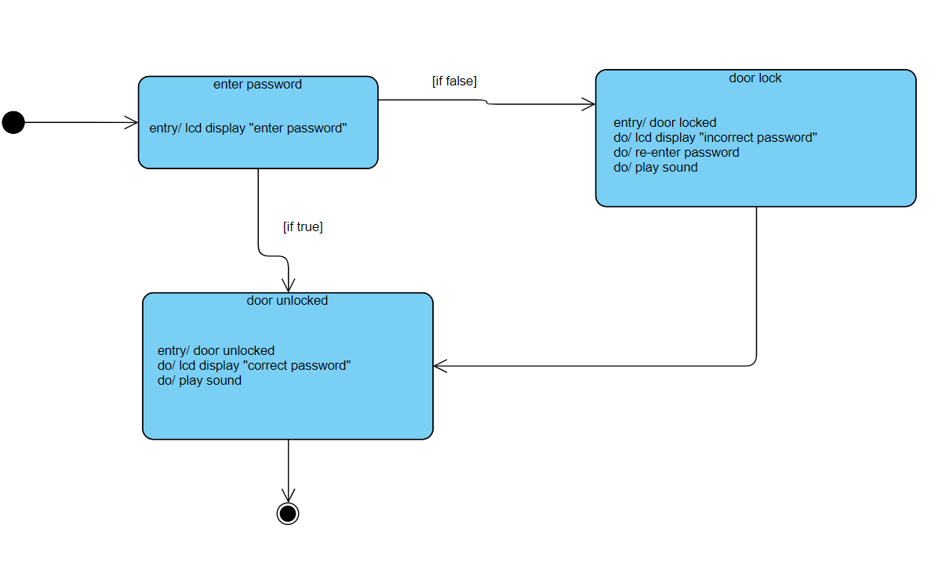
STATE DIAGRAM FOR SMART LOCK DOOR

Slide 23
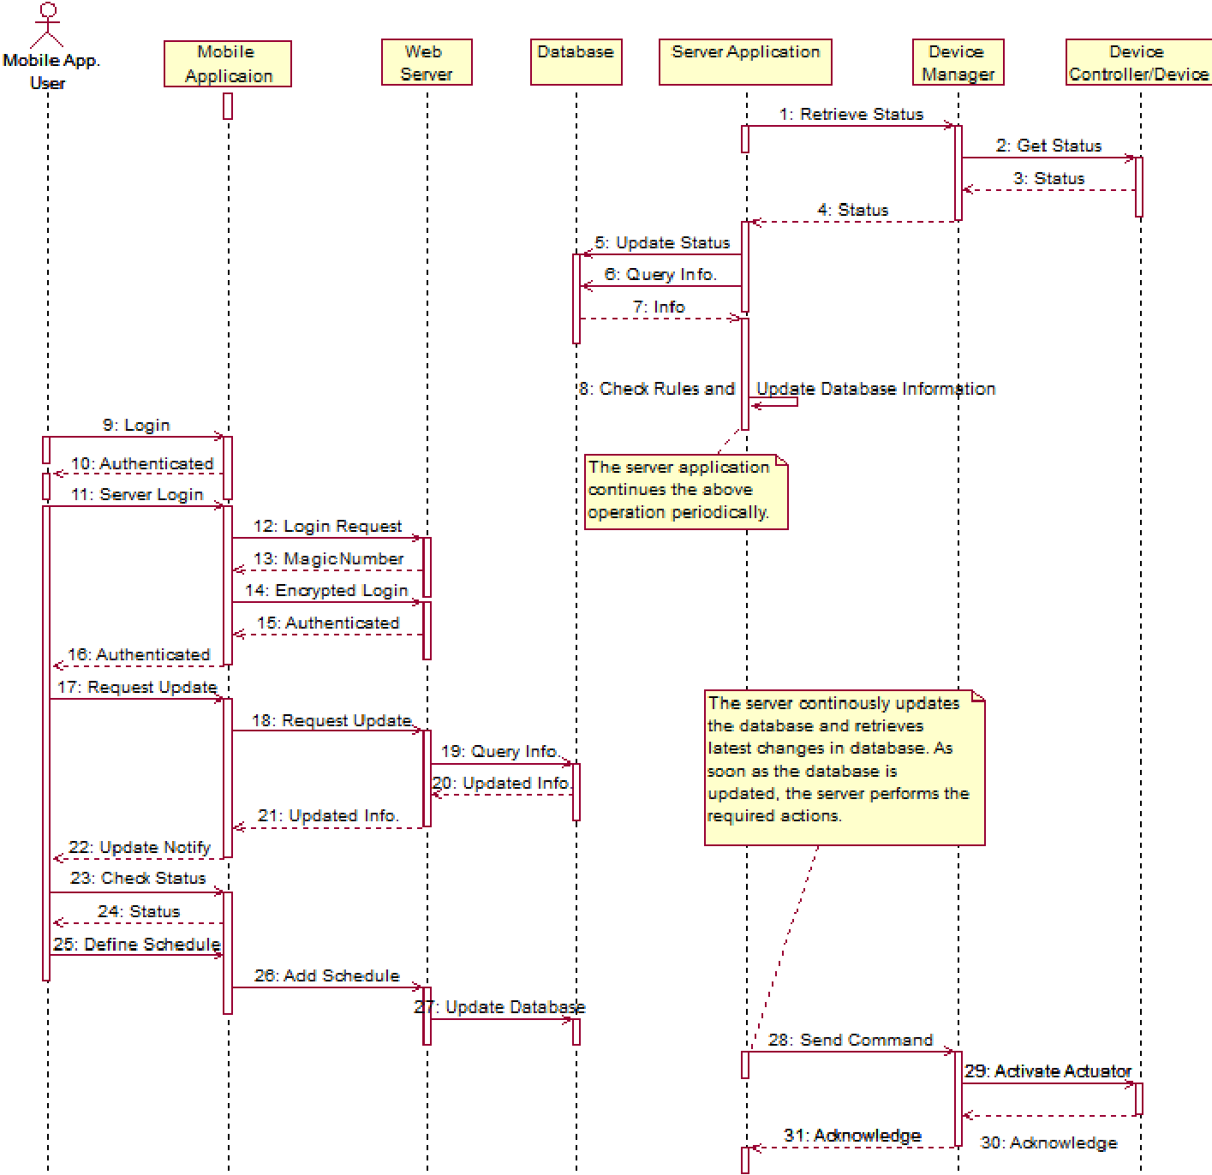
MORE GENERAL FORM

